Slide 1

Women and non-Christian characters in Elizabethan plays
An NLP based approach for Sentimental Analysis using NER & RE

Slide 2
B.Tech Thesis Project
Bhavya Kumar Garg (20UCC033)
Rashi Gupta (20UCC088)
Twishpeeka Rathore (20UCC110)

Slide 3
Elizabethan Plays
Elizabethan plays are plays that were written and performed in England during the reign of Queen Elizabeth I, which lasted from 1558 to 1603. This was a period of great cultural and artistic flourishing in England, and many of the greatest plays in the English language were written during this time.
The most famous Elizabethan playwright was William Shakespeare, who wrote many of his plays during this period. Other notable playwrights of the time include Christopher Marlowe, Ben Jonson, Thomas Kyd, and John Webster.
Many Elizabethan plays were written in blank verse, which is unrhymed iambic pentameter. They often explored themes such as love, power, revenge, and tragedy, and many were based on historical events or stories from mythology.

Slide 4
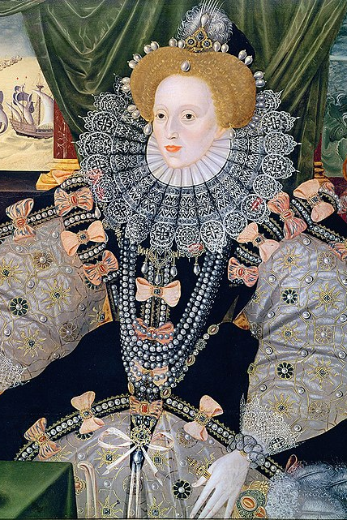
Women in Elizabethan Plays
In terms of female characters, women were often played by male actors in Elizabethan theatre, as women were not allowed to perform on stage at the time. Female characters were typically portrayed as either virtuous and chaste, or as scheming and manipulative. However, there were also some notable exceptions, such as Shakespeare's "Rosalind" in "As You Like It," who was a strong and independent female character who disguised herself as a man in order to navigate the male-dominated world of the play.

Slide 5
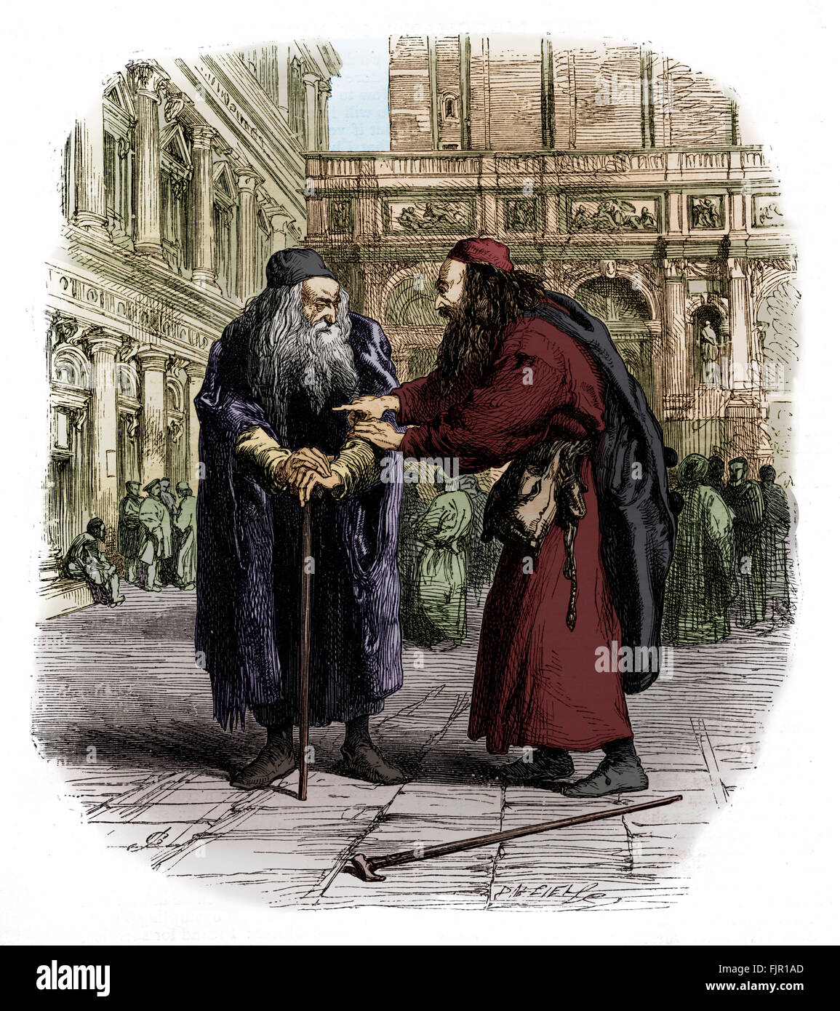
Non-Christians in Elizabethan Plays
Non-Christian characters, particularly Jews and Muslims, were also often depicted in Elizabethan plays, although their portrayal was often negative and stereotypical. For example, Shakespeare's "The Merchant of Venice" features the character of Shylock, a Jewish moneylender who is portrayed as greedy and vengeful. Similarly, Marlowe's "The Jew of Malta" portrays the Jewish character Barabas as a cunning and cruel villain.

Slide 6
In A Nutshell
Women and non-Christian characters were often depicted in Elizabethan plays, although their roles and portrayals varied depending on the specific play and playwright. Overall, while Elizabethan plays did include female and non-Christian characters, their portrayal was often limited and stereotypical, reflecting the cultural and social attitudes of the time.
While these references to women are relatively minor in the play, they do contribute to the overall atmosphere and themes of the work.

Slide 7
Our Aim
So far, humans have been responsible for interpreting these characters, relying on their own understanding of the texts. However, there is significant potential for further analysis of the texts to gain valuable insights into how communities were perceived during the Elizabethan Era. Most conclusions drawn have been based on just a few well-known plays written by a small number of authors, which could be problematic given the large amount of literature yet to be explored.
Due to the limitations of human analysis, we have been motivated to use an NLP-based approach to perform Sentiment Analysis, in order to uncover deeper insights from the plays.

Slide 8

Sentimental Analysis
Sentiment analysis is a natural language processing technique used to determine the emotional tone of a piece of text, such as a tweet, review, or article. The goal of sentiment analysis is to classify the text as positive, negative, or neutral. This is achieved by analysing various features of the text, such as the words used, the context in which they are used, and the overall structure of the text. Sentiment analysis has a wide range of applications, including market research, customer feedback analysis, and social media monitoring.

Slide 9
NLP for Sentimental Analysis
Natural Language Processing (NLP) has become a popular approach for sentiment analysis in recent years. The goal of sentiment analysis is to automatically determine the sentiment expressed in each text, whether it is positive, negative, or neutral. Here are the general steps for building an NLP-based approach for sentiment analysis:
Data collection: Collect data that includes text data with labeled sentiments, such as product reviews or social media posts.
Text pre-processing: This step involves cleaning and preparing the text data for analysis. It typically includes removing stop words, punctuation, and special characters, as well as tokenizing the text into individual words.
Feature extraction: Extract meaningful features from the text data. Some common feature extraction methods include Bag of Words (BoW), Term Frequency-Inverse Document Frequency (TF-IDF), and Word Embeddings.

Slide 10
NLP for SA
Model selection: Select a suitable machine learning model for sentiment classification. Some common models used for sentiment analysis include Naive Bayes, Support Vector Machines (SVM), and Neural Networks (NNs).
Training and evaluation: Train the selected model on the labeled data and evaluate its performance on a holdout set of data. Common evaluation metrics for sentiment analysis include accuracy, precision, recall, and F1-score.
Deployment: Deploy the trained model in a production environment to perform sentiment analysis on new text data.
Overall, NLP-based approaches for sentiment analysis can be effective in accurately identifying the sentiment expressed in text data and can be applied to a variety of use cases, including customer feedback analysis, brand monitoring, and social media sentiment analysis.

Slide 11
Limitations of NLP
While NLP (Natural Language Processing) has made significant advancements in recent years, there are still some limitations to its approach, including:
Ambiguity: Natural language is often ambiguous, and words or phrases can have multiple meanings depending on the context in which they are used. This can make it difficult for NLP models to accurately interpret and understand the meaning of a text.
Contextual understanding: Understanding the meaning of a text requires contextual understanding, which can be challenging for NLP models. NLP models may not be able to capture the nuances of human language and may struggle with idiomatic expressions, humour, and sarcasm.
Data availability and quality: NLP models rely on large amounts of high-quality data to be trained effectively. However, obtaining and labelling large amounts of data can be time-consuming and costly.

Slide 12
Bias: NLP models can be biased, which can lead to inaccurate or unfair results. This bias can be introduced through the training data, the algorithms used, or the design of the model itself.
Multilingual support: While NLP has made significant strides in supporting multiple languages there are still many languages for which NLP tools are not available or not as accurate.
Privacy concerns: The use of NLP for text analysis raises concerns around privacy, particularly when it comes to sensitive personal information. The misuse of NLP tools could lead to violations of privacy and other ethical concerns.

Slide 13
Sentiment Analysis
Machine Learning
Approach
Lexicon-based Approach
Supervised
Learning
Unsupervised
Learning
Dictionary-Based Approach
Corpus-Based Approach
Decision-tree classifiers
Linear classifiers
Rule-based classifiers
Probabilistic classifiers

Slide 14
Literature survey
Sentiment analysis algorithms and applications: A survey
by Walaa Medhat, Ahmed Hassan and Hoda Korashy, DEC 2014
https://www.sciencedirect.com/science/article/pii/S2090447914000550
This research paper tackles a comprehensive overview of the last update in this field. Many recently proposed algorithms' enhancements and various SA applications are investigated and presented briefly in this survey. These articles are categorized according to their contributions in the various SA techniques. The related fields to SA. The main contributions of this paper include the sophisticated categorizations of a large number of recent articles and the illustration of the recent trend of research in the sentiment analysis and its related areas.

Slide 15
Literature survey
Sentiment Analysis Using VADER
by Juveriya Mahreen OCT, 2022
https://www.analyticsvidhya.com/blog/2022/10/sentiment-analysis-using-vader/#:~:text=VADER(%20Valence%20Aware%20Dictionary%20for,as%20either%20positive%20or%20negative
The article explains how to use VADER (Valence Aware Dictionary for Sentiment Reasoning) for sentiment analysis. VADER is a rule-based sentiment analysis tool that is specifically designed to analyze social media text, which often includes slang, abbreviations, and other informal language. Overall, the article provides a useful introduction to VADER and demonstrates how it can be used for sentiment analysis. It also highlights the importance of choosing the right sentiment analysis tool based on the specific application and domain, and the need for ongoing evaluation and refinement of sentiment analysis models.

Slide 16
Literature survey
Text2emotion: Python package to detect emotions from textual data
by Amey Band SEPT 2020
https://towardsdatascience.com/text2emotion-python-package-to-detect-emotions-from-textual-data-b2e7b7ce1153
This was published in 'Towards Data Science' helps us discover the emotions in textual messages. Text2Emotion is a Python package that uses machine learning algorithms to detect emotions from textual data. It can be used to analyze the emotional tone of social media posts, customer feedback, or any other form of text data.
The package uses a deep learning model trained on a large corpus of text data to classify text into seven emotion categories: anger, fear, joy, love, sadness, surprise, and neutral. It uses a combination of text preprocessing, feature extraction, and classification techniques to accurately identify emotions in text.
Text2Emotion can be used in a variety of applications, such as sentiment analysis, customer feedback analysis, and social media monitoring. It is easy to use and can be integrated with other Python packages and libraries.

Slide 17
Literature survey
Relation Extraction | Natural Language Processing
by Chandresh Maurya MAR, 2021
https://www.youtube.com/watch?v=t0R3NdT1vGY
Through this talk we learn about the concepts of Relation Extraction. Relation Extraction is a process of identifying and extracting the connections between different things or entities mentioned in a text. This task involves analyzing the text and identifying the entities involved, such as people, places, or things, and then determining how they are related to each other. The goal of relation extraction is to extract these structured relationships from unstructured text data, which can be valuable for a wide range of applications.
One of the key challenges associated with relation extraction is determining the correct relationships between entities. This can be especially difficult when dealing with complex or ambiguous text. Additionally, different types of relations may require different extraction techniques, and the quality of the extracted relations can be affected by factors such as the quality of the input data and the specific extraction algorithm used.

Slide 18
Lexicon-based Approach
The lexicon-based approach to sentiment analysis uses pre-defined dictionaries or lexicons with assigned sentiment scores.
Lexicons can be manually created or generated using machine learning techniques.
The approach matches words in the text with the words in the lexicon and aggregates sentiment scores to determine overall sentiment.
This approach is simple and computationally efficient but may struggle with sarcasm, irony, or words with multiple meanings.
It requires a comprehensive and accurate lexicon to produce reliable results.
The lexicon-based approach is often used as a baseline for sentiment analysis models.
It can be combined with other techniques to improve accuracy.

Slide 19
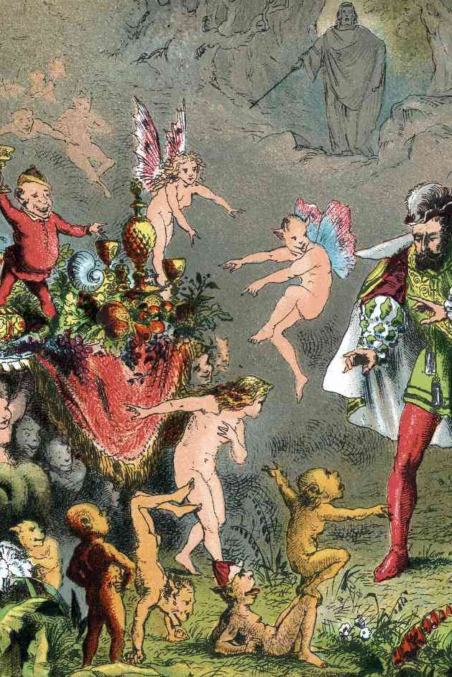
The Tempest
"The Tempest" is a play written by William Shakespeare, believed to have been written around 1610–1611. The play is set on a remote island, where the exiled Duke of Milan, Prospero, uses his magic powers to manipulate the events that take place on the island.
The play is notable for its exploration of themes such as the abuse of power, the nature of forgiveness, and the relationship between art and illusion. It also features a diverse range of characters, including the sprite Ariel, the monstrous Caliban, and the shipwrecked nobles Alonso, Antonio, and Ferdinand.

Slide 20
SA on “The Tempest”
Approach used: Lexicon Based
Libraries used:
NLTK
VADER
Text2Emotion
Source used for eBook: https://www.gutenberg.org/files/23042/23042-0.txt

Slide 21
NLTK
VADER
Text2emotion
Natural Language Toolkit
Python library that provides tools and resources for working with human language data.
In this case, used to tokenize the text into sentences.
Valence Aware Dictionary and sentiment Reasoner
Dictionary-Based Approach
Contains over 7,500 lexical features, including words, phrases, and emoticons, each with an associated positive, negative, and neutral sentiment score.
Also considers other factors such as punctuation, capitalization, and degree modifiers (such as "very" or "extremely").
Text2emotion is the python package developed with the clear intension to find the appropriate emotions embedded in the text data.
Processes any textual data, recognizes the emotion embedded in it, and provides the output in the form of a dictionary.
Well suited with 5 basic emotion categories such as Happy, Angry, Sad, Surprise and Fear.

Slide 22
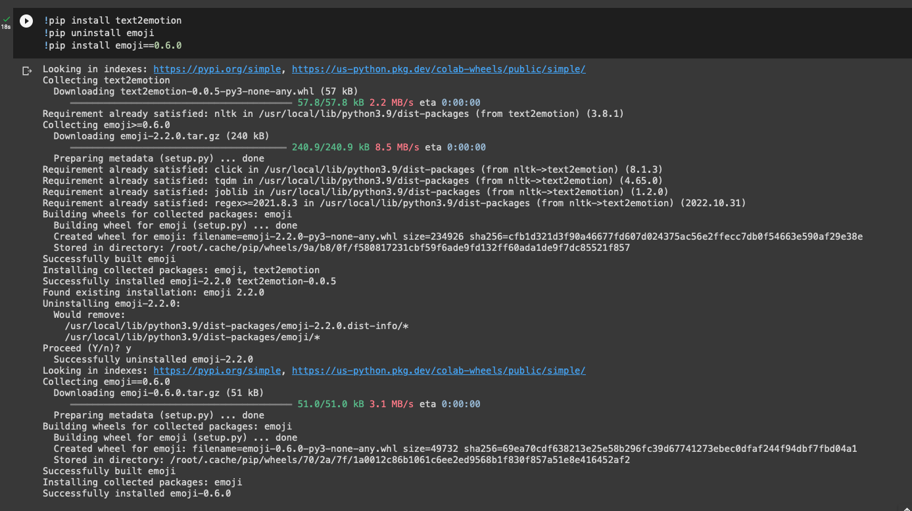
Installing necessary libraries.

Slide 23
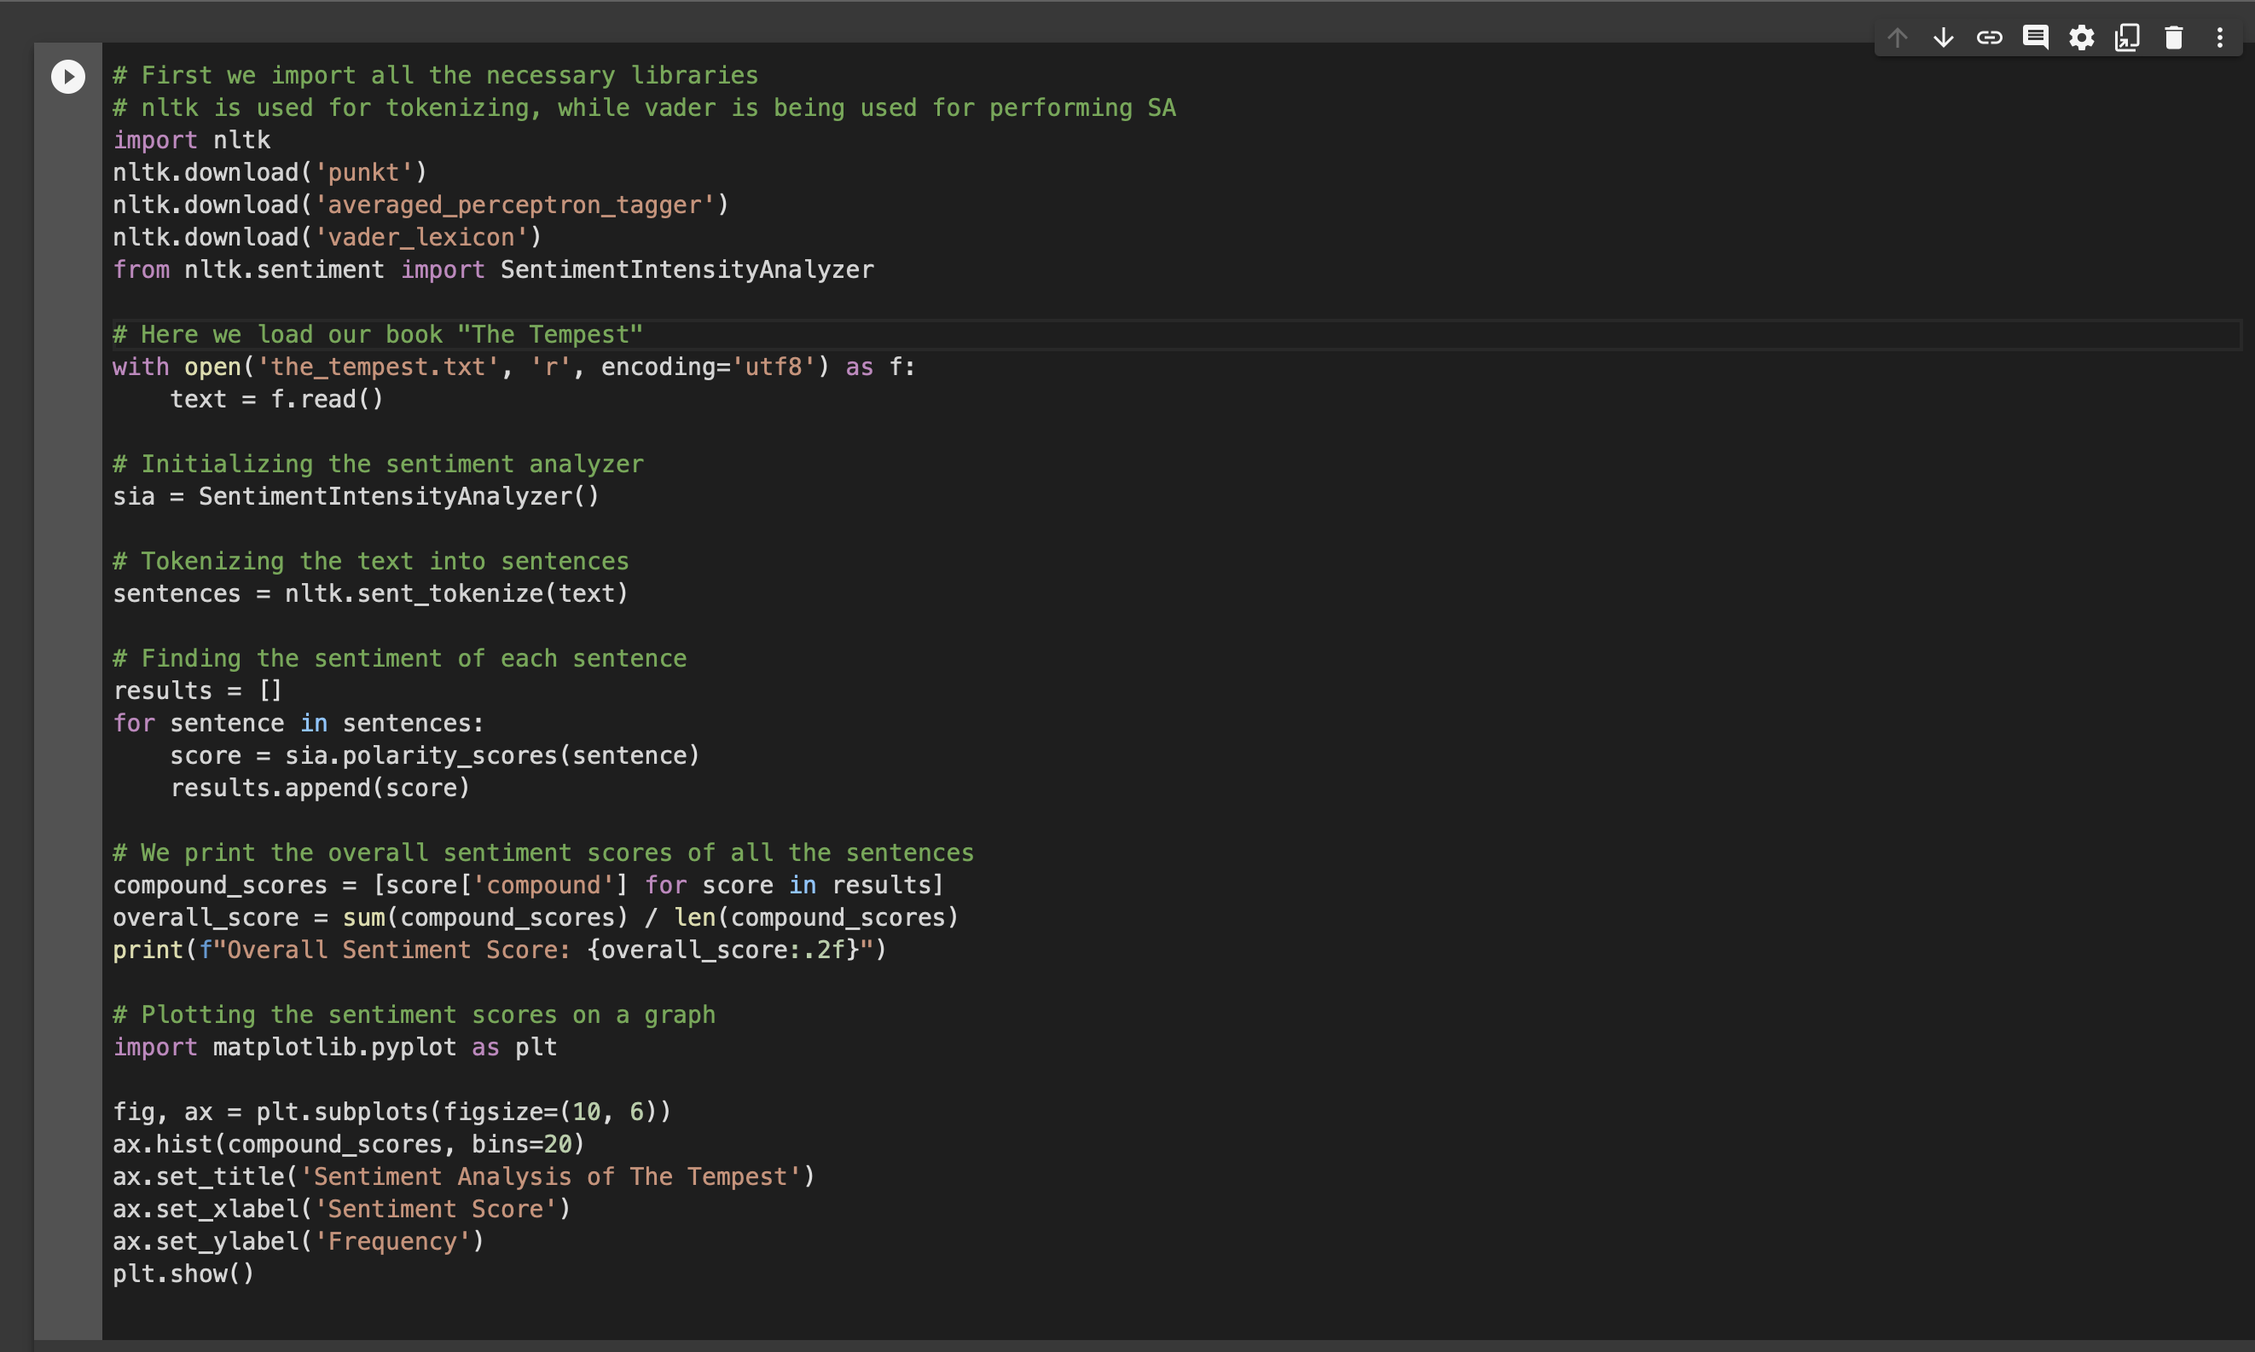
Python code to perform SA on the complete book.

Slide 24
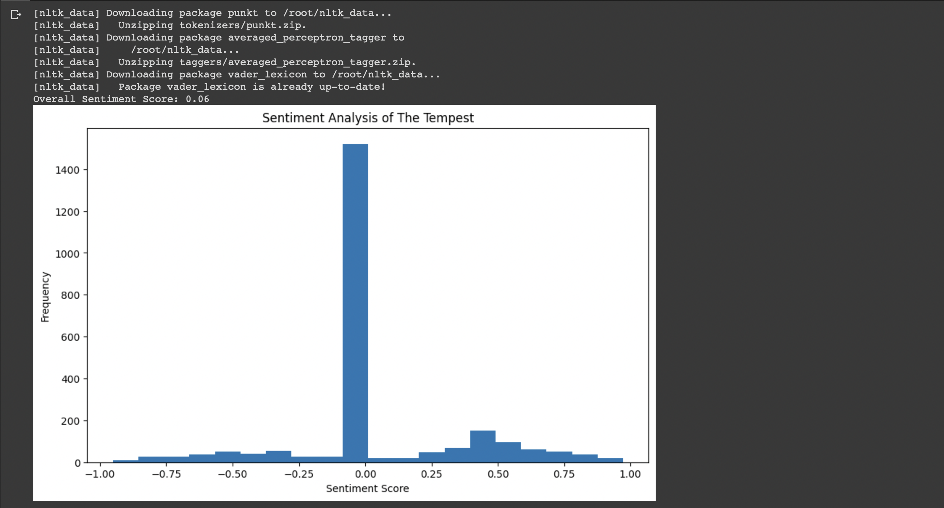
Results

Slide 25
Python code to perform SA on PROSPERO
import requests
from bs4 import BeautifulSoup
import nltk
nltk.download('punkt')
nltk.download('vader_lexicon')
from nltk.sentiment.vader import SentimentIntensityAnalyzer
import text2emotion as te
# Download the text of "The Tempest"
url = "https://www.gutenberg.org/files/23042/23042-0.txt"
response = requests.get(url)
text = response.content.decode('utf-8')
# Use NLTK to tokenize the text into sentences
sentences = nltk.sent_tokenize(text)
# Filter out sentences spoken by the character
character_sentences = [s for s in sentences if '_Pros._' in s]
# Character name
character_name = "PROSPERO"

Slide 26
Python code to perform SA on PROSPERO
# Initialize emotion counts
emotions = {
"Happy": 0,
"Sad": 0,
"Angry": 0,
"Surprise": 0,
"Fear": 0
}
# Iterate through the sentences and count emotions for the character
for sentence in sentences:
if character_name.lower() in sentence.lower():
sentence_emotions = te.get_emotion(sentence)
for emotion, value in sentence_emotions.items():
emotions[emotion] += value
# Print the emotion counts for the character
print("\nEmotions for", character_name, ":", emotions,"\n")
# Initialize the SentimentIntensityAnalyzer
sia = SentimentIntensityAnalyzer()

Slide 27
Python code to perform SA on PROSPERO
# Analyze sentiment of each sentence spoken by the character
results = []
for sentence in character_sentences:
score = sia.polarity_scores(sentence)
results.append(score)
# Print the compound sentiment score for each sentence spoken by the character
print("Sentiment analysis for the character:")
for i, score in enumerate(results):
print(f"Sentence {i+1}: {score['compound']:.2f}")
# We print the overall sentiment scores of all the sentences
compound_scores = [score['compound'] for score in results]
overall_score = sum(compound_scores) / len(compound_scores)
print(f"Overall Sentiment Score: {overall_score:.2f}")
# Visualize the sentiment scores
import matplotlib.pyplot as plt
fig, ax = plt.subplots(figsize=(10, 6))
ax.hist(compound_scores, bins=20)
ax.set_title('Sentiment Analysis of the character')
ax.set_xlabel('Sentiment Score')
ax.set_ylabel('Frequency')
plt.show()

Slide 28
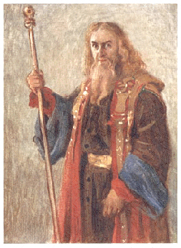
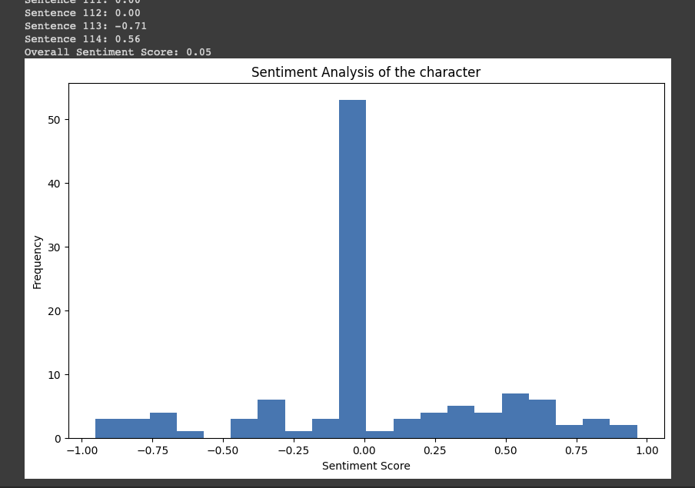
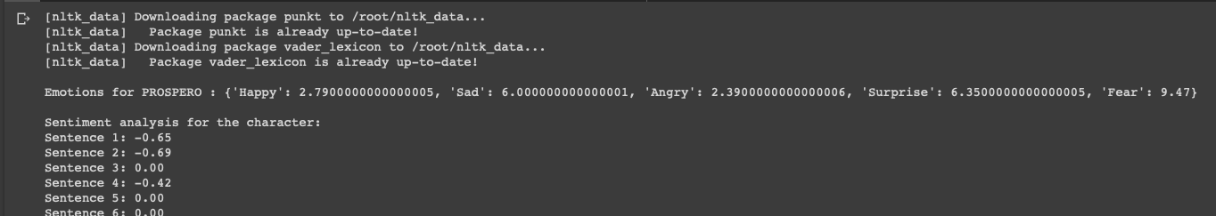
Results on PROSPERO

Slide 29

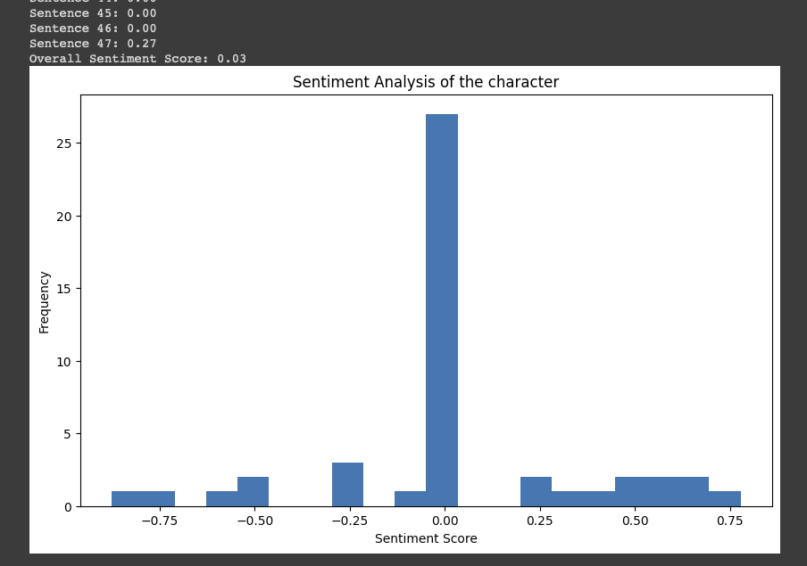
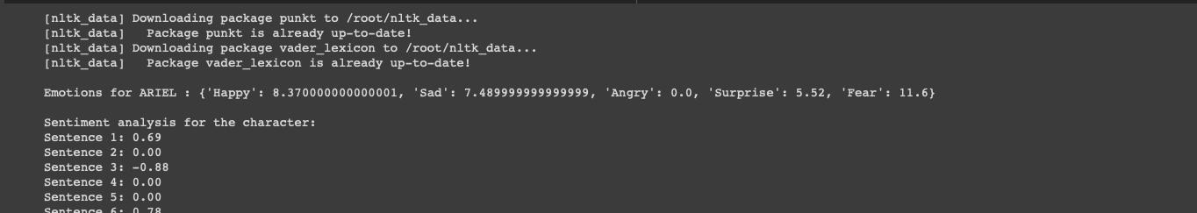
Results on ARIEL

Slide 30

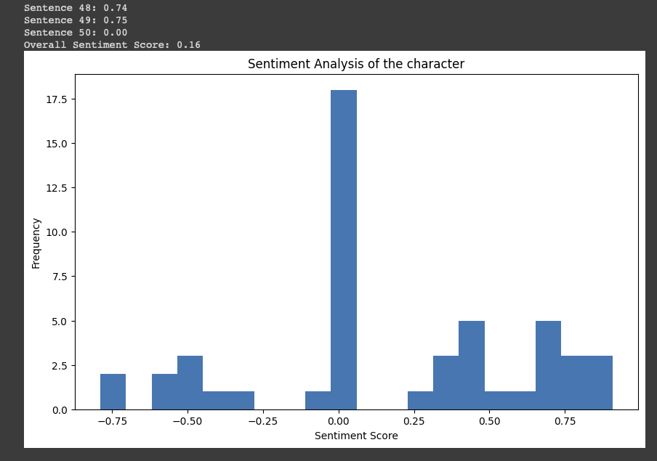
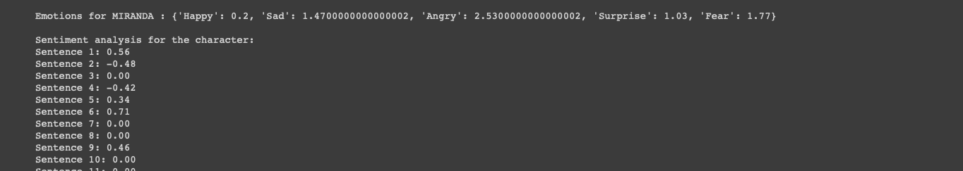
Results on MIRANDA

Slide 31
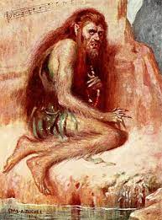
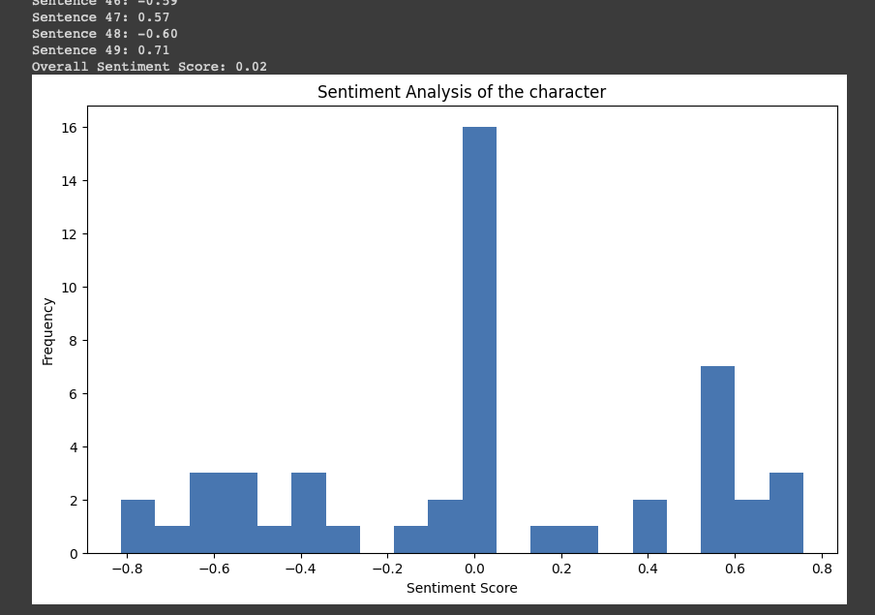
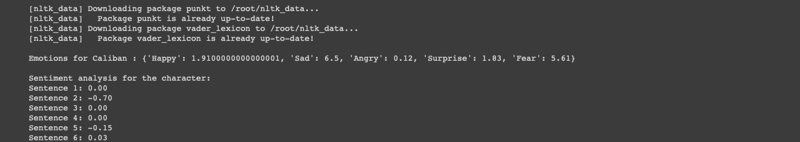
Results on CALIBAN

Slide 32
Conclusion – ED Results
POLARITY SCORE

Slide 33
Machine Learning Approach
The machine learning approach for sentiment analysis involves training a model to predict sentiment based on labelled examples.
Relevant features are selected from the text, such as the frequency of certain words or phrases.
These features are used to train a machine learning algorithm, such as a decision tree, Naive Bayes, or neural network.
The trained model can then predict the sentiment of new, unlabelled text.
This approach can handle more complex language usage, such as sarcasm and irony, and can adapt to new contexts or domains.
However, it requires a large amount of labelled data for training and can be computationally intensive.
The machine learning approach is widely used in sentiment analysis applications, such as social media monitoring, customer feedback analysis, and brand reputation management.

Slide 34
Named-Entity-Recognition (NER)
Named entity recognition (NER) is a natural language processing (NLP) technique that involves identifying and categorizing named entities in text. Named entities are specific objects, people, places, organizations, and other entities that have a unique name or identifier. NER is used to automatically identify and extract these entities from unstructured text data.
There are several tools and libraries available for named entity recognition (NER) that can be used for natural language processing tasks. Some of the commonly used tools for NER include SpaCy and NLTK.

Slide 35
Relation-Extraction (RE)
Relation extraction is a natural language processing (NLP) task that involves identifying and extracting semantic relationships between entities in text. The goal of relation extraction is to automatically identify and classify the relationships between entities, such as people, organizations, and locations, that are mentioned in the text.
There are several techniques used for relation extraction, including rule-based systems, machine learning models, and deep learning models. Rule-based systems use handcrafted rules to identify and classify relationships, while machine learning models use algorithms to learn patterns in the data and automatically identify relationships. Deep learning models, such as neural networks, have been shown to be effective in relation extraction tasks, as they can learn complex patterns in the text data.

Slide 36
Plan of Action
Identifying and classifying named entities.
Extracting Relations between the entities.
Creating our own KB
Using our KB, find all the relations in the corpus
Perform sentimental analysis.

Slide 37
Problems in RE
Relation extraction is complicated and tedious to work with. There are some problems with it
We need an existing knowledge base to start with , we cannot start it from scratch.
Multiple relations exists.
There is a dependency on the previous text.

Slide 38
References
NLTK documentation : https://www.nltk.org
Vader (Geeksforgeeks) : https://www.geeksforgeeks.org/python-sentiment-analysis-using-vader/
Text2Emotion (Python documentation) : https://pypi.org/project/text2emotion/
NER (Github) : https://github.com/raaga500/YTshared/blob/master/V3_NamedEntityReco_3.ipynb
RE: http://nlpprogress.com/english/relationship_extraction.html

Slide 39

We express our sincere gratitude to our respected supervisor sir, Dr. Narendra Kumar for their invaluable guidance and support throughout our Bachelor Thesis Project. Your patience, and commitment has motivated us to successfully complete the project.

Slide 40
Plan of Action - Part II
Topic summary
What and why we are doing
Role of SA in our project
Recap of previous work
Motivation for further research – Improving accuracy
Area’s to improve
Dependency of emotions on multiple entities
Language barrier
RE – Solving dependency issue
Limitations of RE – Beyond Scope
Multiple translations – Solving language issue

Slide 42
Recap

